Slide 1

Error Analysis
Carrying out error
analysis
deeplearning.ai

Slide 2
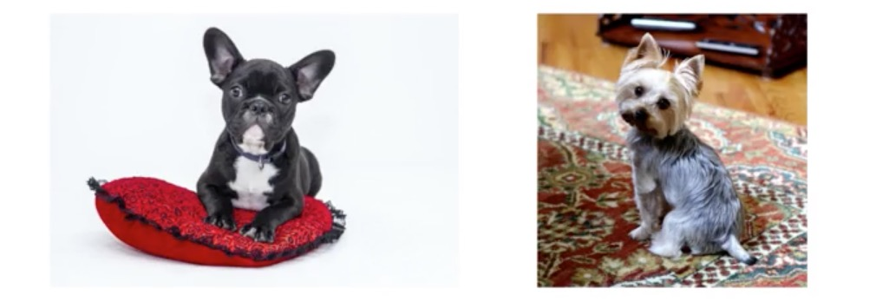
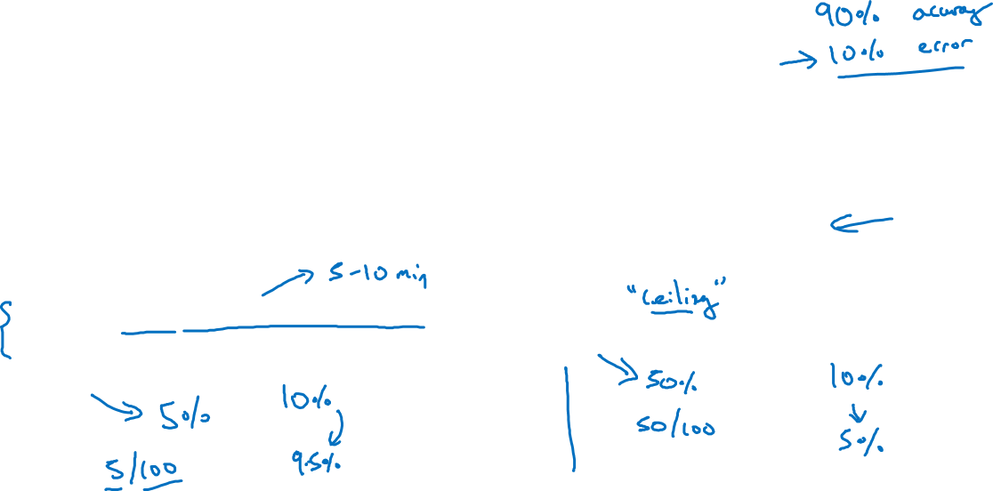
Look at dev examples to evaluate ideas
Should you try to make your cat classifier do better on dogs?
Error analysis:
Get ~100 mislabeled dev set examples.
Count up how many are dogs.

Slide 3
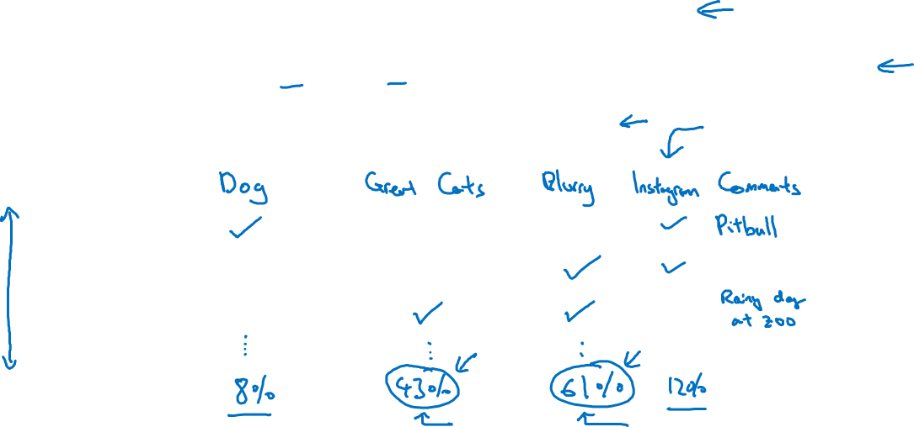
Evaluate multiple ideas in parallel
Ideas for cat detection:
Fix pictures of dogs being recognized as cats
Fix great cats (lions, panthers, etc..) being misrecognized
Improve performance on blurry images
Image
1
2
3
% of total
.
.
.

Slide 4
Error Analysis
Cleaning up
Incorrectly labeled data
deeplearning.ai

Slide 5
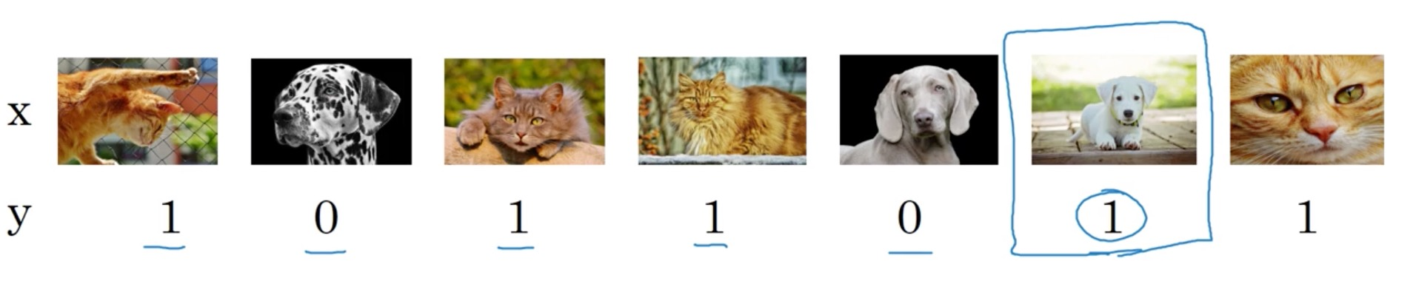
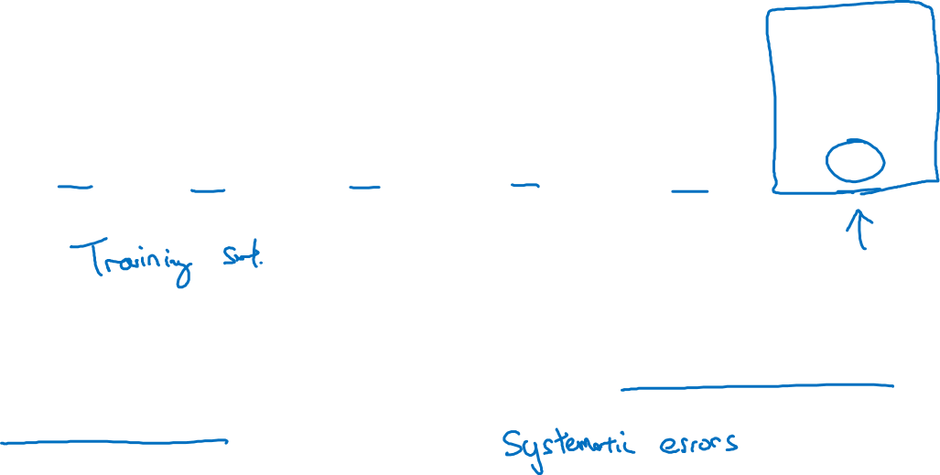
Incorrectly labeled examples
DL algorithms are quite robust to random errors in the
training set.

Slide 6
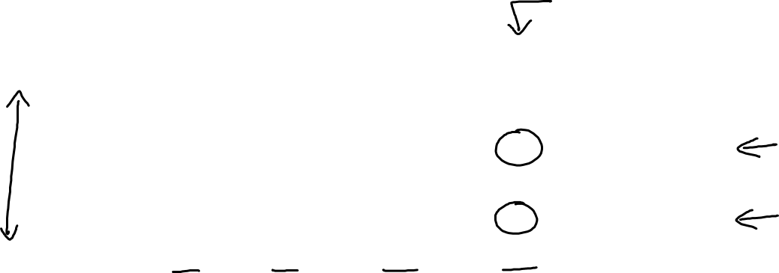
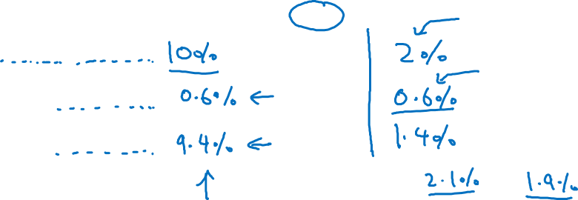
Error analysis
Image | Dog | Great Cat | Blurry | Incorrectly labeled | Comments
…
98 |  |  |  | ✓ | Labeler missed cat in background
99 |  | ✓
100 |  |  |  | ✓ | Drawing of a cat; Not a real cat.
% of total | 8% | 43% | 61% | 6%
Overall dev set error
Errors due incorrect labels
Errors due to other causes
Goal of dev set is to help you select between two classifiers A & B.

Slide 7
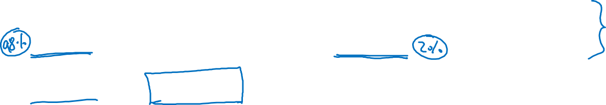
Correcting incorrect dev/test set examples
Apply same process to your dev and test sets to make sure they continue to come from the same distribution
Consider examining examples your algorithm got right as well as ones it got wrong.
Train and dev/test data may now come from slightly different distributions.

Slide 8
Error Analysis
Build your first system
quickly, then iterate
deeplearning.ai

Slide 9
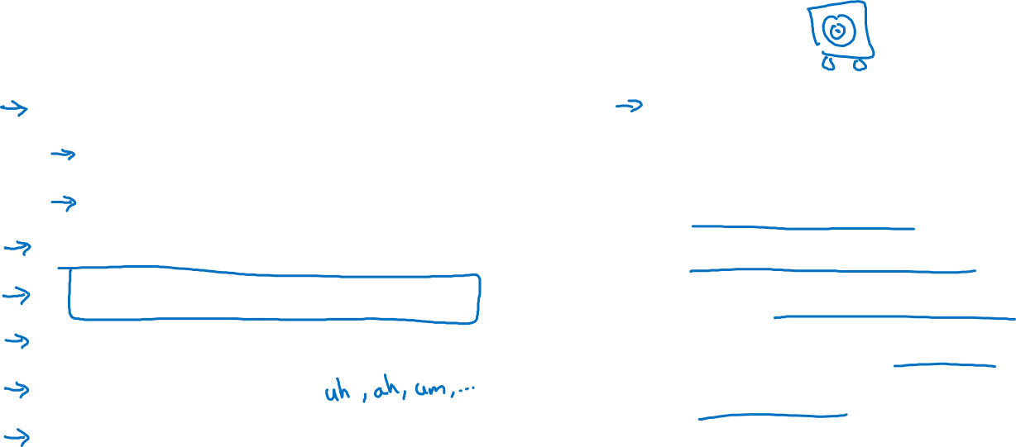
Speech recognition example
Noisy background
Café noise
Car noise
Accented speech
Far from microphone
Young children’s speech
Stuttering
…
Set up dev/test set and metric
Build initial system quickly
Use Bias/Variance analysis & Error analysis to prioritize next steps.
Guideline: Build your first system quickly, then iterate

Slide 10
Mismatched training and dev/test data
Training and testing on different distributions
deeplearning.ai

Slide 11
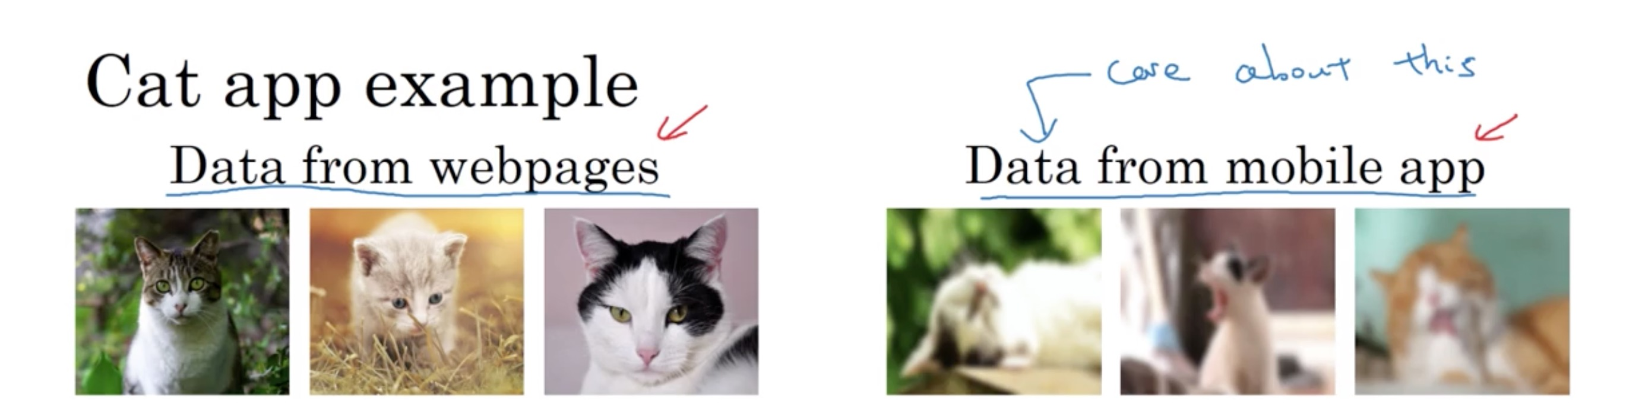
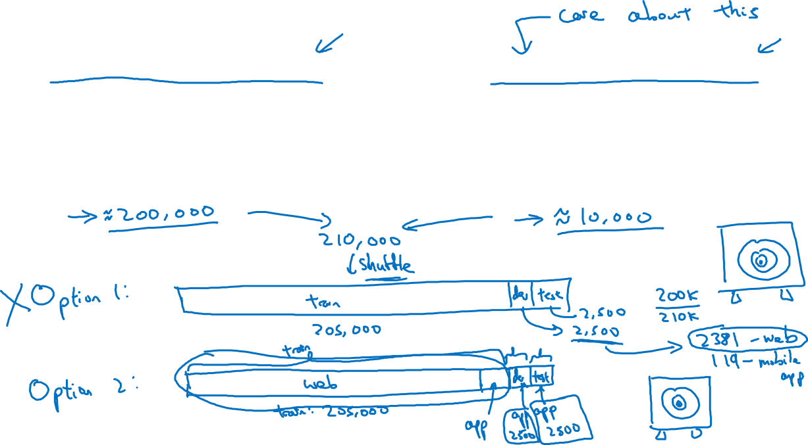

Slide 12
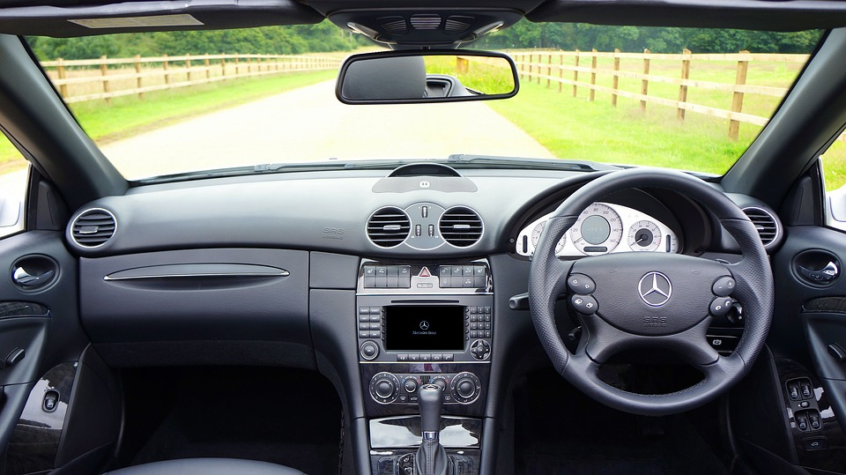
Speech recognition example
Training
Dev/test
Purchased data
Speech activated rearview mirror
Smart speaker control
Voice keyboard
…

Slide 13
Mismatched training and dev/test data
Bias and Variance with
mismatched data
distributions
deeplearning.ai

Slide 14
Cat classifier example
Assume humans get ≈ 0% error.
Training error
Dev error
Training-dev set: Same distribution as training set, but not used for training

Slide 15
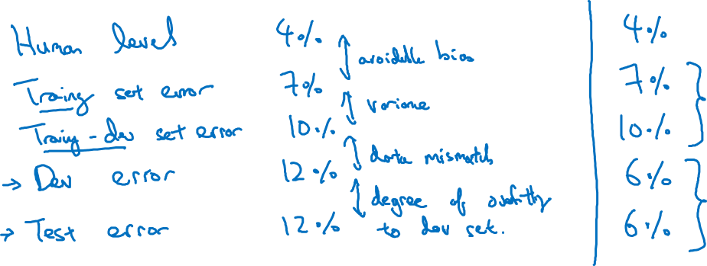
Bias/variance on mismatched training and dev/test sets

Slide 16
More general formulation

Slide 17
Mismatched training and dev/test data
Addressing data
mismatch
deeplearning.ai

Slide 18
Addressing data mismatch
Carry out manual error analysis to try to understand difference
between training and dev/test sets
Make training data more similar; or collect more data similar to
dev/test sets

Slide 19

Artificial data synthesis
+
=
“The quick brown fox jumps
over the lazy dog.”
Car noise
Synthesized
in-car audio

Slide 20
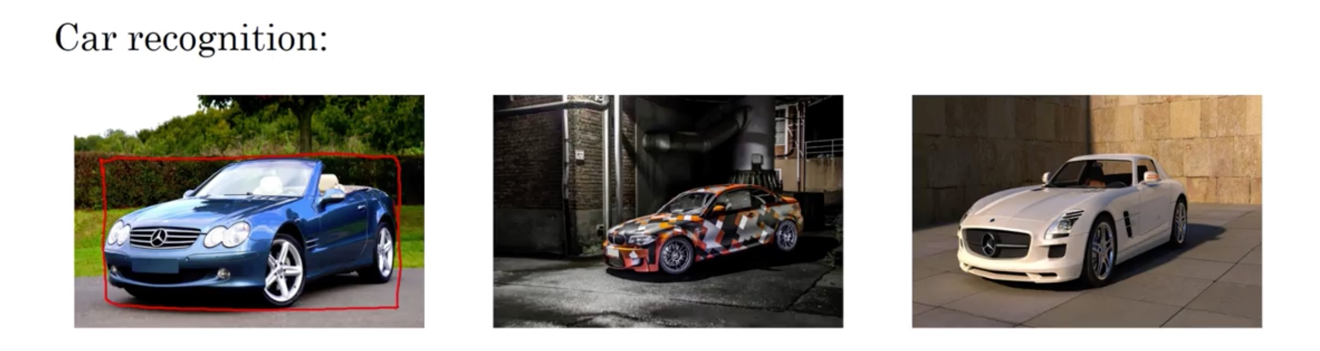
Artificial data synthesis

Slide 21
Learning from multiple tasks
Transfer learning
deeplearning.ai

Slide 22
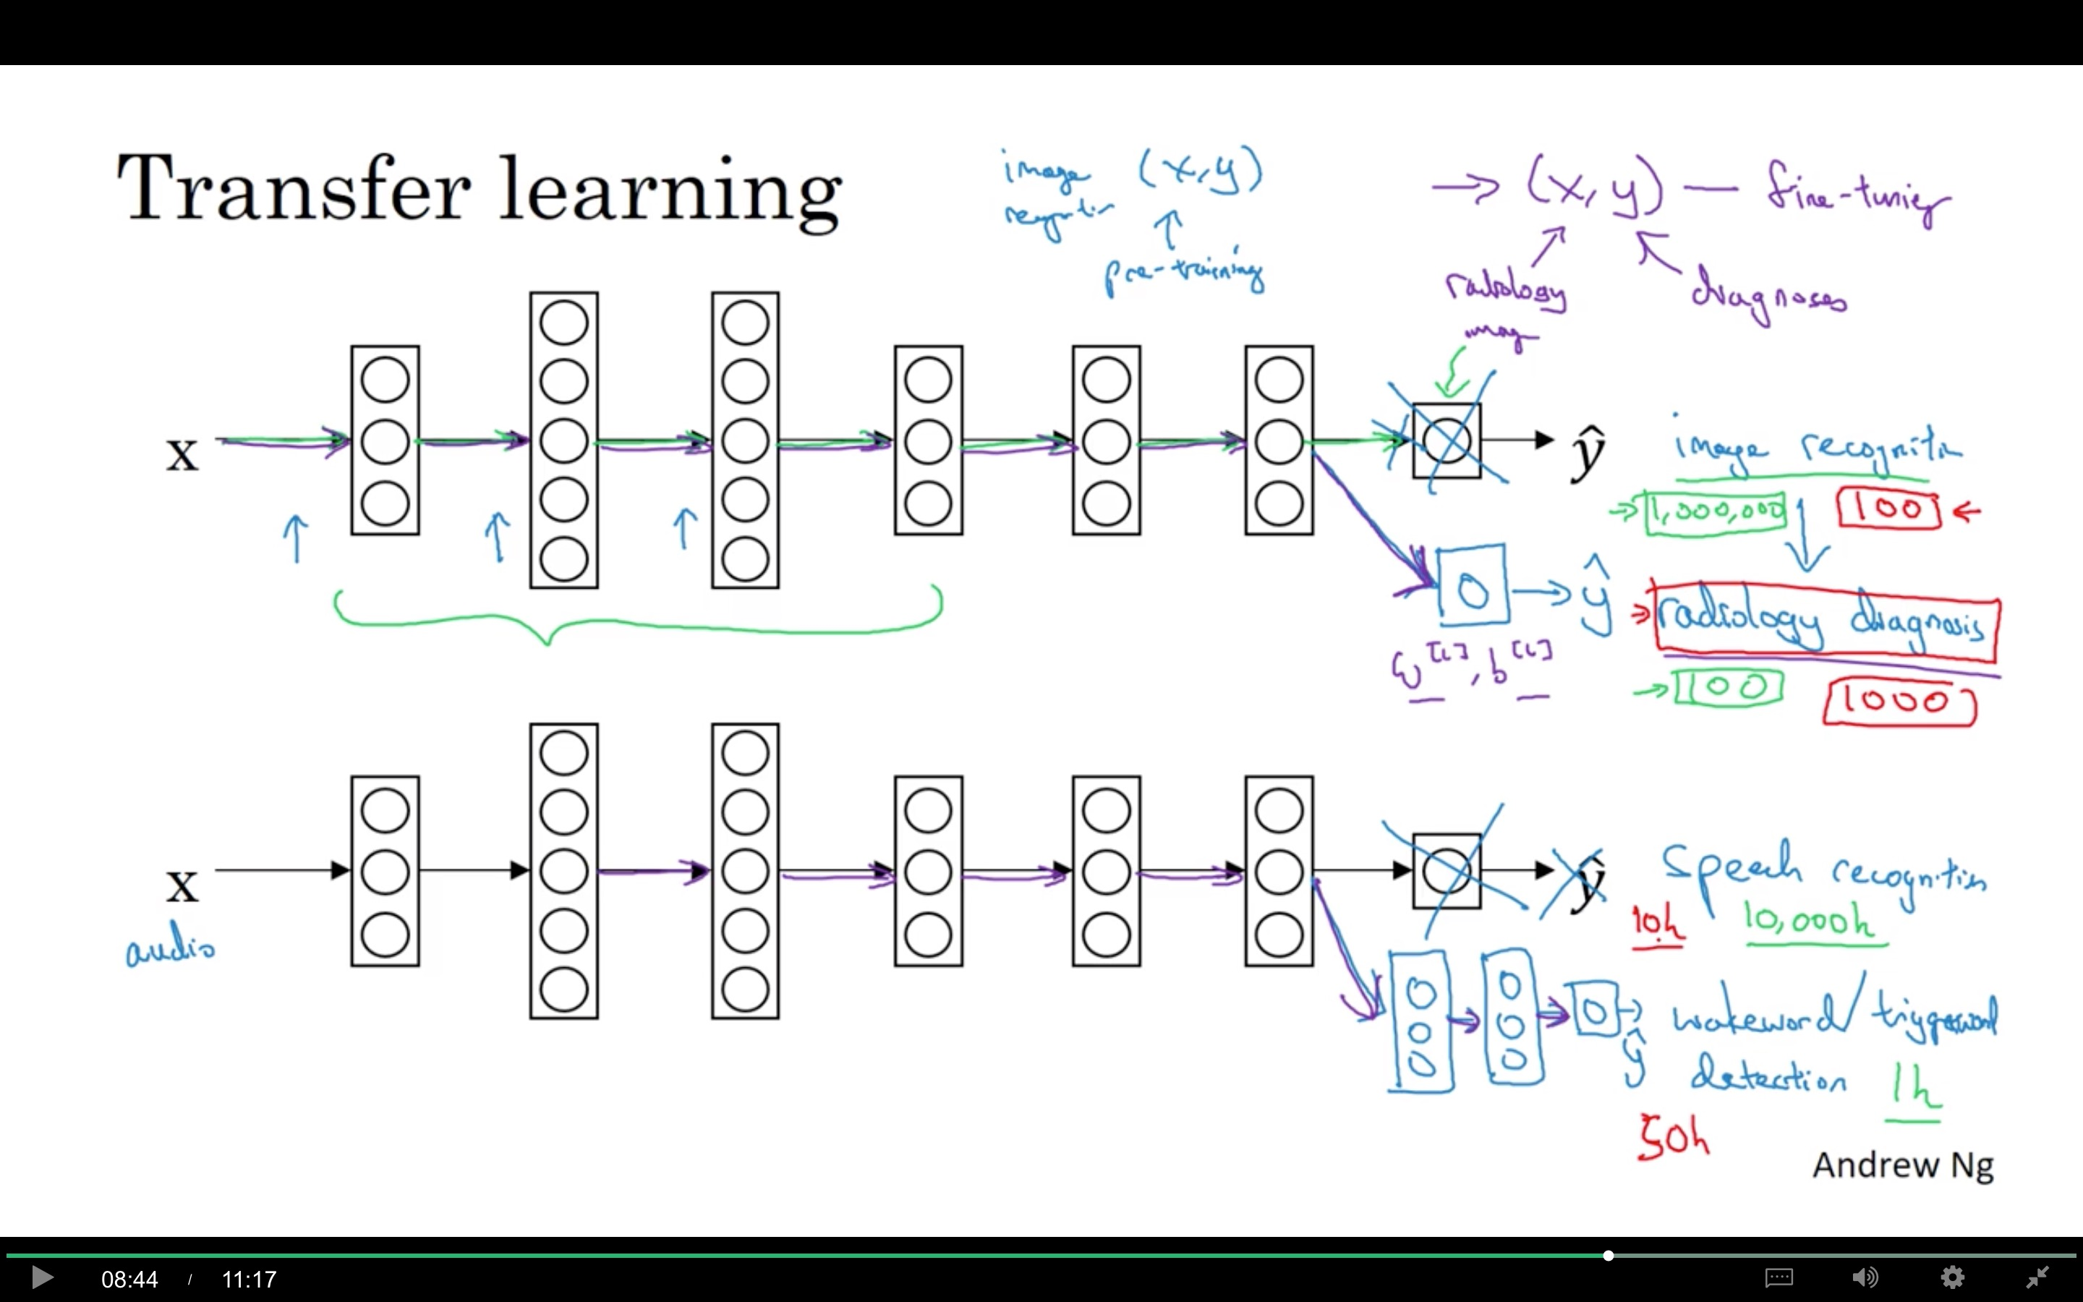

Slide 23
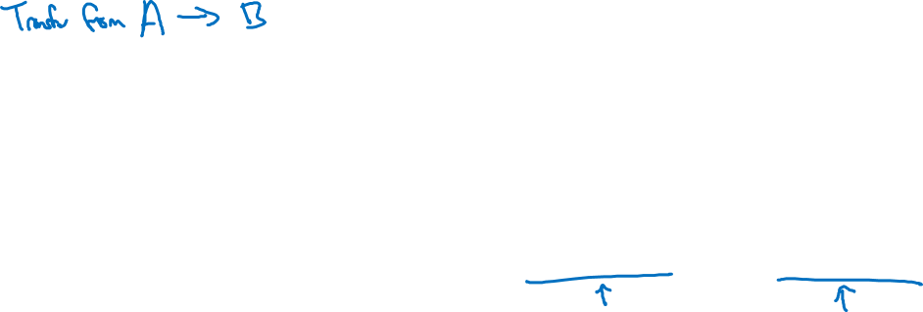
When transfer learning makes sense
Task A and B have the same input x.
You have a lot more data for Task A than Task B.
Low level features from A could be helpful for learning B.

Slide 24
Learning from multiple tasks
Multi-task learning
deeplearning.ai

Slide 25
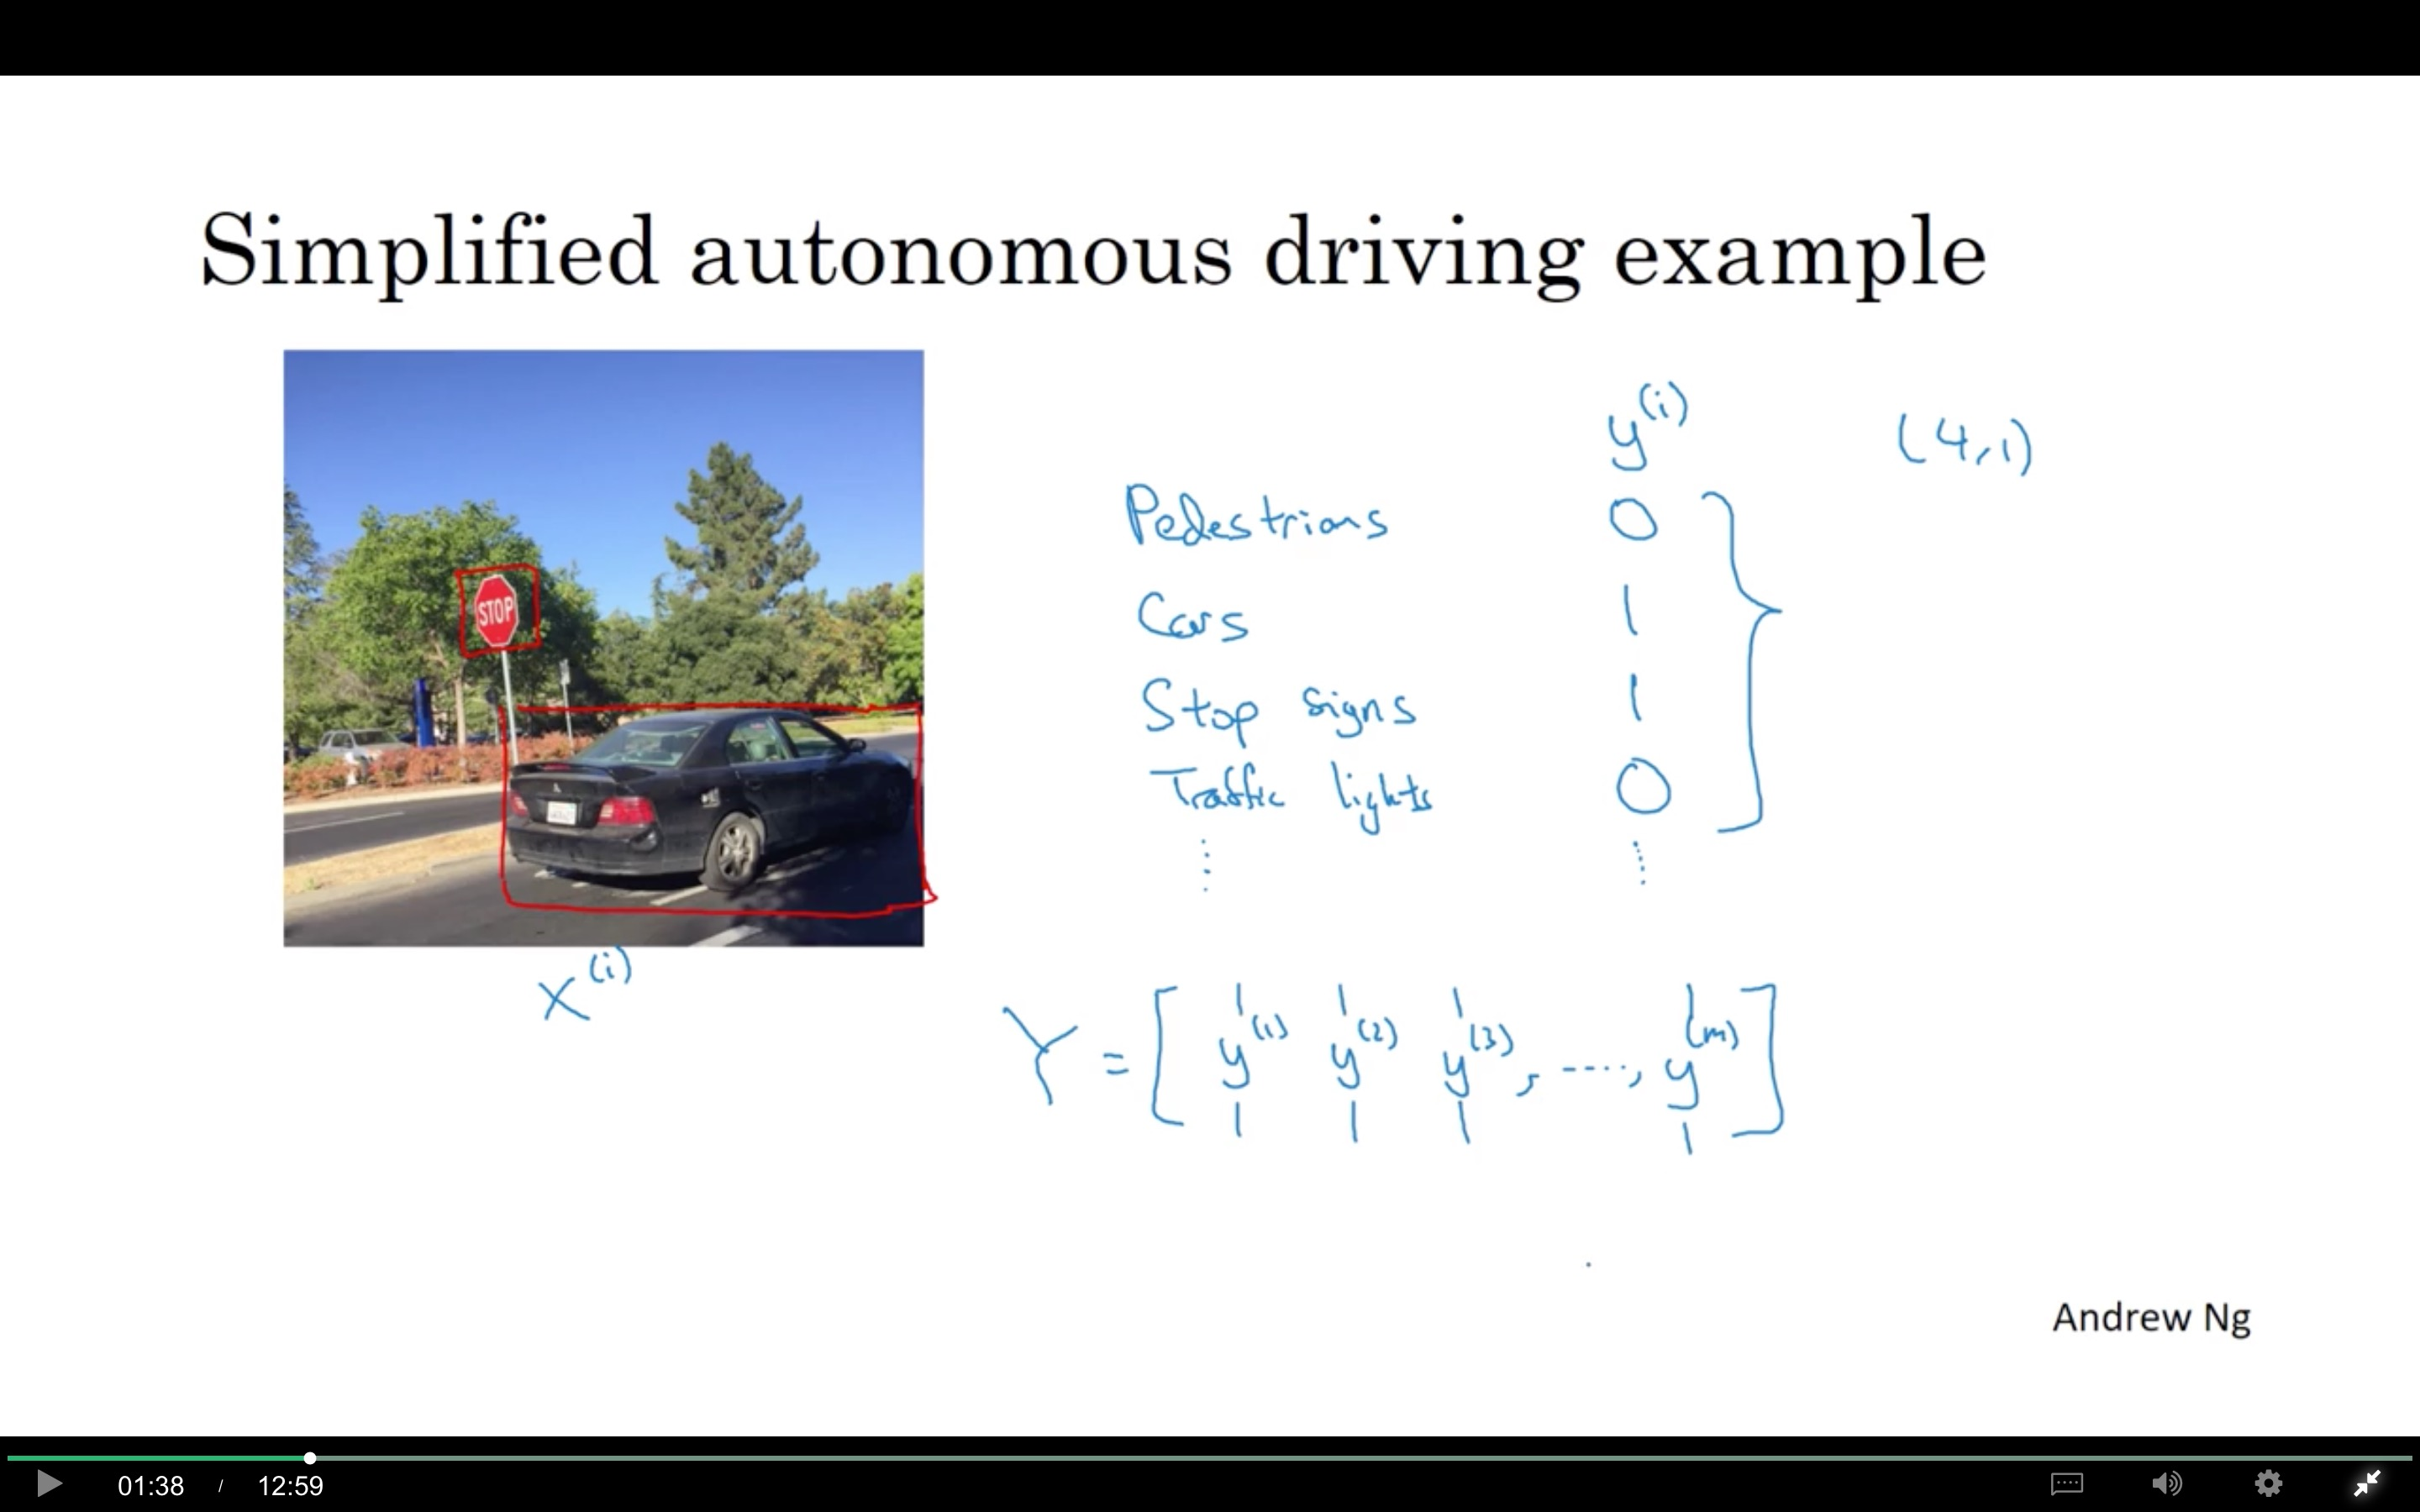

Slide 26

Neural network architecture
x
$$\hat{y}$$

Slide 27
When multi-task learning makes sense
Training on a set of tasks that could benefit from having shared lower-level features.
Usually: Amount of data you have for each task is quite similar.
Can train a big enough neural network to do well on all the tasks.

Slide 28
End-to-end deep learning
What is
end-to-end
deep learning
deeplearning.ai

Slide 29
What is end-to-end learning?
Speech recognition example

Slide 30
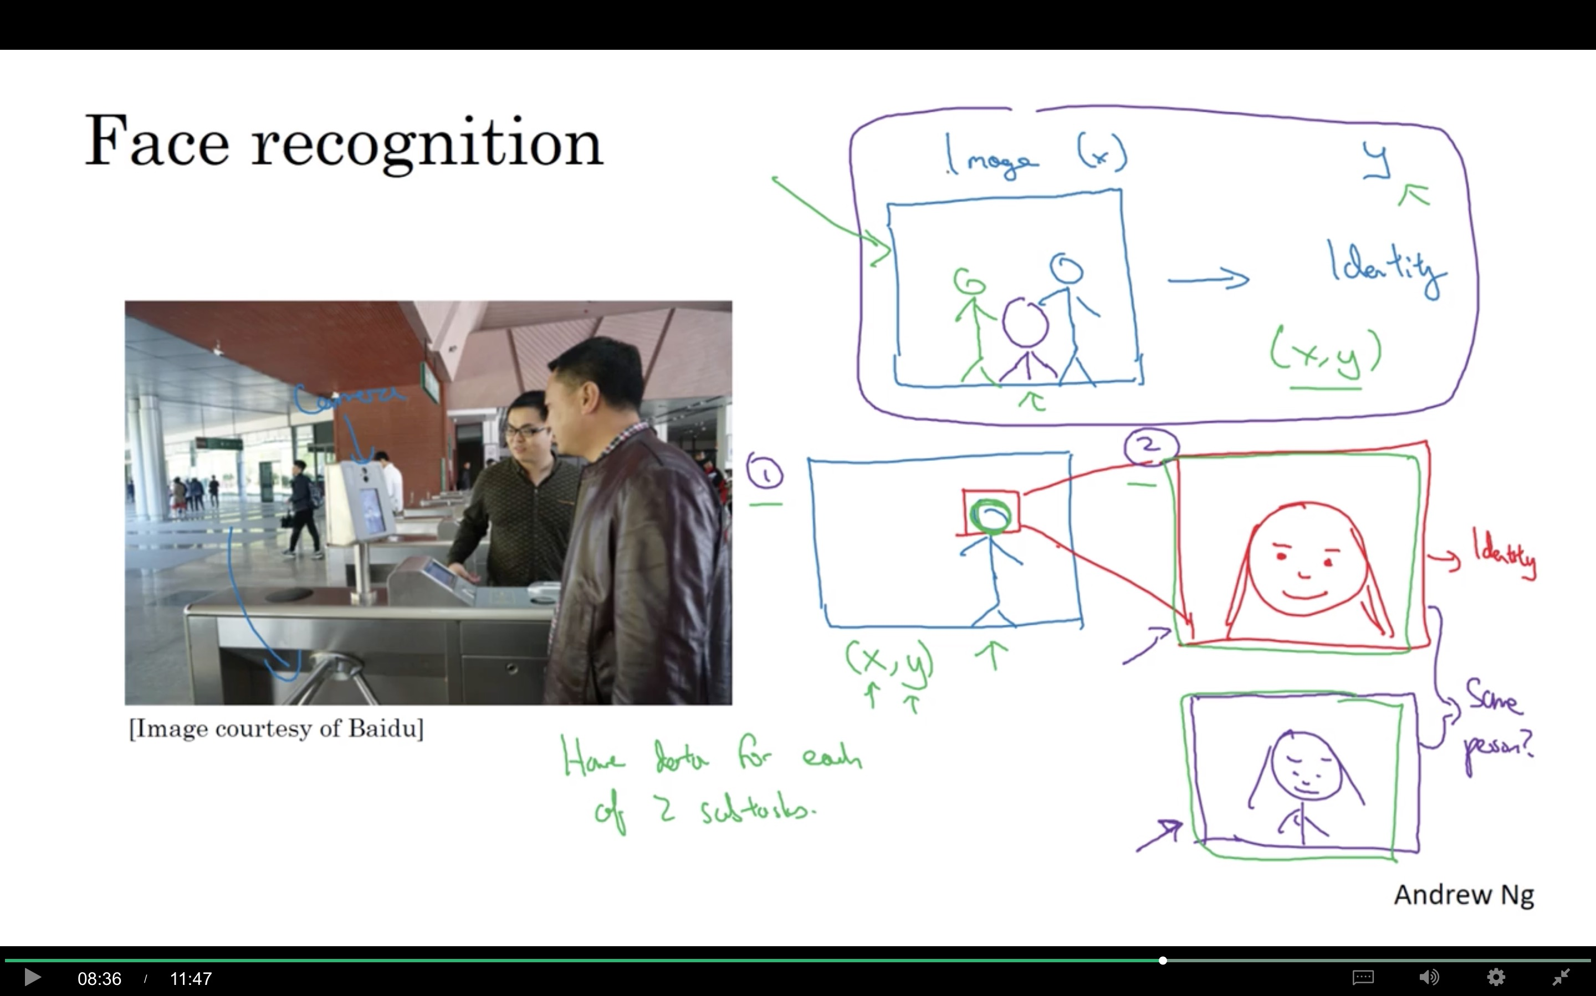

Slide 31
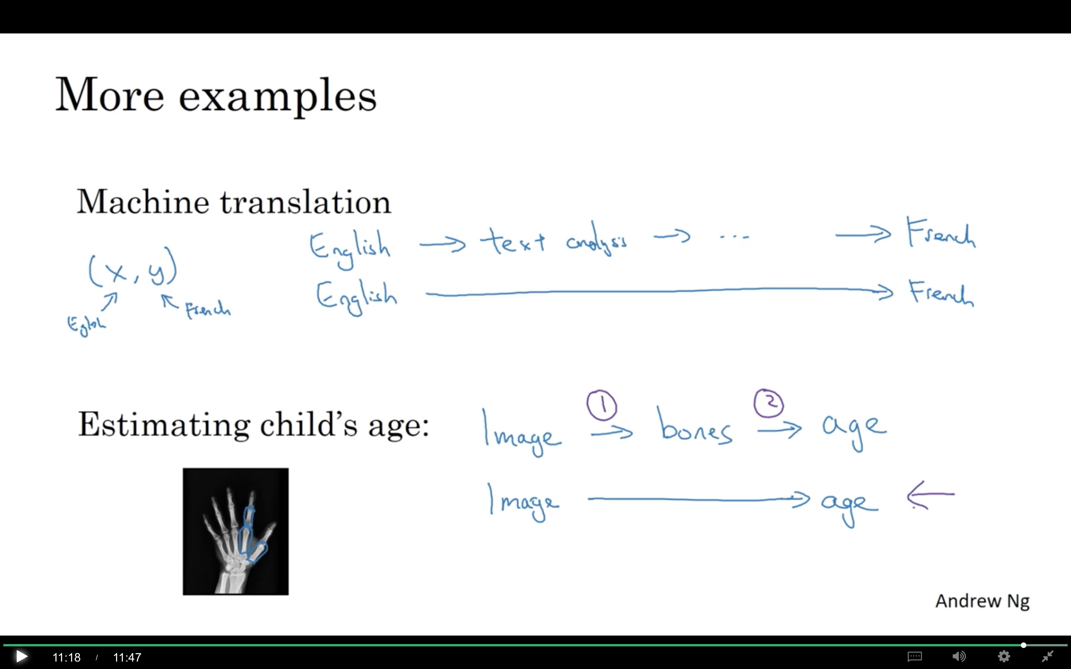

Slide 32
End-to-end deep learning
Whether to use
end-to-end learning
deeplearning.ai

Slide 33
Pros and cons of end-to-end deep learning
Pros:
Let the data speak
Less hand-designing of components needed
Cons:
May need large amount of data
Excludes potentially useful hand-designed components

Slide 34
